Slide 1
Course Outcome
1.Perform basic operations on arrays
2.Apply different searching and sorting techniques
3.Implement basic operations on stack and queue using array representation
4.Implement basic operations on linked list
5.Implement program to create and traverse tree to solve problems.

Slide 2
Chapter 1 to 5
1. Introduction to Data Structure :- 06M
2.Searching and sorting :- 12 M
3. Stack and queue: 20M
4. Linked list:16 M
5. Tree and graph:16M

Slide 3
Ch1:- Introduction to Data Structures
Data is a collection of numbers, alphabets and symbols combined to represent information.
A computer takes data as input and after processing of data it produces output.

Slide 4
2 types of data
1.Atomic Data :- It is a non-decomposible entity.
Ex:- an integer value 523 or character value ‘A’.
2.Composite data:- It is a combination of several atomic data and hence it can be further divided into automic data.
Ex:- date of birth (15/3/1984)
15:- day of the month
3:- Month
1984:- Year

Slide 5
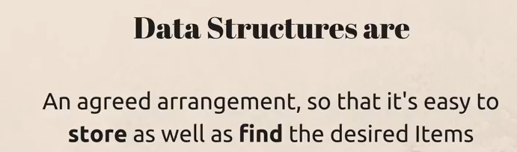
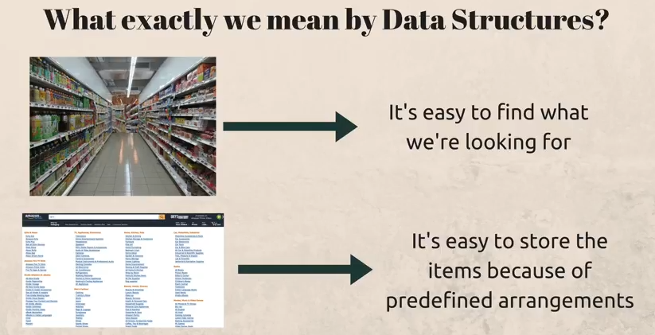

Slide 6
What is data Structure
Data Structure is a container who stores the Data.
A data structure is a scheme for organizing data in the memory of a computer.
Data structure deals with representation of data considering not only the elements stored but also their relationship to each other.
For writing an efficient program ,a proper data structure should be selected.

Slide 7
What is data Structure
A proper data structure should be selected so that the relationship between data elements can be expressed.
Processing and accessing of data should be efficient.
DS can also be defined as an instance(example) of ADT.

Slide 8
Need for Data Structure
1.A data structure helps us to understand the relationship of one data element with the other.
2.DS helps us to analyze the data in a logical or mathematical manner.
3.DS helps us to store the data and organize in a logical or mathematical manner.
4.Now a day computing problems are complex and large ,so there is need to handle large amount of data which is overcome by using DS.

Slide 9
Need for Data Structure
To identify a solution for a data processing problem,4 things have to be identified:-
The data elements that are concerned with the problem.
The operations that will be performed on these data elements.
Methods of storing the data elements in memory to retain the logical relationship between them.
The programming language which suits the current requirements

Slide 10
Need for Data Structure
Example: Calculate area of circle
1.The data elements are radius ,pi and area
2.The operations performed on the above data elements are multiplication and assignment
3.They can be stored in memory as bits/bytes and the user can access them in different forms.
Example-integer, float etc.
4.Languages like c ,c++,pascal etc. can be used to solve the above problem.

Slide 11
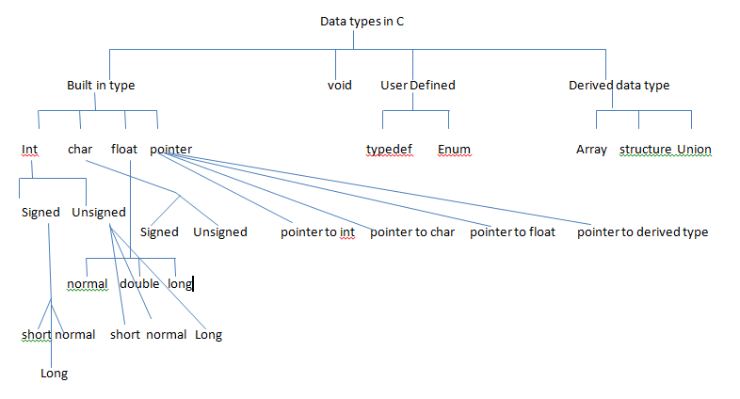
Data Types in C

Slide 12
User defined Type
“Type defination” allows user to define an identifier that will represent an existing data type.
Example:- typedef float marks
After above declaration marks can be used for float
i.e marks phy,che,math
Here marks is another name for float.

Slide 13
Enumerated data type
Example:-
enum day(Mon,Tue,Wed,Thu,Fri,Sat,Sun);
enum day today;
Here variable today which Is declared of enum day type can be assigned a value from the set(Mon,Tue,Wed,Thu,Fri,Sat,Sun)
i.e today=Thu;
i.e if(today==Mon)
i.e today=Fri
All above 3 statements are valid statements

Slide 14
Derived Data type
Array ,Structure ,Union,pointer
In structure each member has its own storage location, whereas all the members of a union use the same location

Slide 15
ADT:-Abstract Data Type
ADT combines the description of data and its associated operations on these values.
ADT provides 2 characteristics:-
1.Description of element in term of data types
2.Defines relationship among individual elements

Slide 16
ADT
ADT is a logical description of how we view the data and operations that are allowed without regard to flow they will be implemented.
In short ADT means hiding the information without knowing its implementation.

Slide 17
Types of DS
There are 2 types of DS
1.Primitive DS
a. Integer
b. Char
c. Float
2.Non-primitive DS(derived)
a. Linear DS
b. Non-Linear DS

Slide 18
1.Primitive DS:-
The int, char, float, pointer are primitive ds and these data types are available in most programming languages as built in type.
a. Integer
b. Character
c. Float
d. Pointer

Slide 19
2.Non-Primitive DS
These DS are derived from primitive DS.
It is a set of similar or different data items.
2 types of Non-Primitive DS
a. Linear DS:
1. Array 2.Stack 3.Queue 4.Linked List
b. Non-Linear DS:
1.Trees 2.Graph

Slide 20
Linear DS
Linear means “In a Line”
The elements of a linear data structure are arranged in a line i.e. in a sequence or list.
Their mapping is one dimensional.
In a linear DS every data element has a unique successor and unique predecessor.
Example:-Array ,linked list, stack and queue

Slide 21
Array
Array is a collection of data of same data type stored in consecutive memory location and is referred by a common name.
Int no[5];
1000 1001 1002 1003 1004
1 | 2 | 3 | 4 | 5

Slide 22
Linked List
Linked List is a collection of data of same data type but the data items need not be stored in consecutive memory locations.
The elements are linked using pointers.

Slide 23
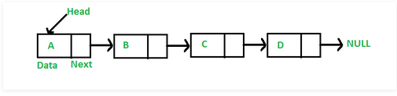
In linked list each element is a separate object. Each element (we will call it a node) of a list is comprising of two items - the data and a reference to the next node. The last node has a reference to null.

Slide 24
Why Linked List?
Arrays can be used to store data of similar types, but arrays have following limitations.
The size of the arrays is fixed
Inserting a new element in an array of elements is expensive, because room has to be created for the new elements and to create room existing elements have to shifted.

Slide 25
Operations on Linked List:-
Traversing all the elements in a linked list
Searching for an element in the linked list
Insertion of an element
Deletion of an element

Slide 26
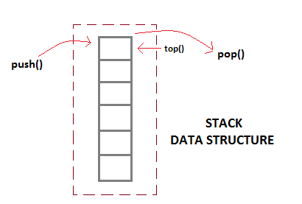
Stack
A stack is a data structure consisting a list of element in which elements can be inserted or deleted at one end which is called as TOP of the stack.

Slide 27
Stack
Every time an element is added, it goes on the top of the stack and the only element that can be removed is the element that is at the top of the stack, just like a pile of objects.
Stack is a LIFO(Last in First out) structure
push() function is used to insert new elements into the Stack
pop() function is used to remove an element from the stack. Both insertion and removal are allowed at only one end of Stack called Top.

Slide 28
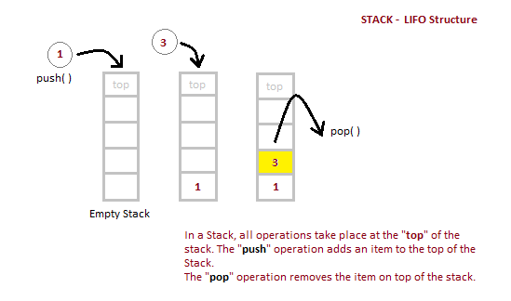

Slide 29
Stack
Stack is said to be in Overflow state when it is completely full and is said to be in Underflow state if it is completely empty.
The simplest application of a stack is to reverse a word. You push a given word to stack - letter by letter - and then pop letters from the stack.

Slide 30
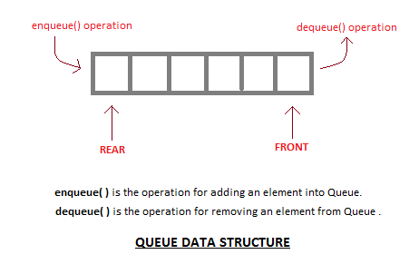
Queue
A queue is open at both its ends.

Slide 31
One end is always used to insert data (enqueue)
And the other is used to remove data (dequeue)
Queue follows First-In-First-Out methodology, i.e., the data item stored first will be accessed first.

Slide 32
Operations performed on Queue:-
1.Insertion:- insert or add an element to the queue(REAR end)
2.Deletion:- Deleting an element from a queue (FRONT end)

Slide 33
Non-Linear DS
Non-Linear DS are used to represent the data containing hierarchical or network relationship between the elements.
In a non-linear DS ,the elements have a one to many relationship between them.
Types of Non-Linear DS are:-
1.Tree
2.Graph

Slide 34
Tree
A tree is a widely used DS that represents a hierarchical relationship among the data elements.
A tree is a collection of nodes in a recursive manner.

Slide 35
Graph
Graphs are set of inter connected nodes having a specific value.
Graph is used to represent data that has relationship between pair of elements not necessary hierarchical in nature.

Slide 36
Operations on DS
1.Traversing:- It involves processing each element in the
list exactly once.
Example:- Print the values of all the elements in the array.
2.Searching:-Finding any element or the record using a
key is called searching.
Ex:- Find out names of all the students who secured 90
marks in maths

Slide 37
Operations on DS
3.Inserting:-
It is used to add new data items in the given list
Ex:- Add the details of a new student who has recently joined the course.
4.Deleting:-
It is used to remove a particular data item from the given list.

Slide 38
Operations on DS
5.Sorting:-
Data items can be arranged in some order like ascending or descending order.
6.Merging:-
List of two sorting data items can be combined to form a single list of sorted data items.

Slide 39
Algorithm
Algorithm is set of ordered instructions which are written in simple English language.
Algorithm defines the step by step logic for a program to solve specific problem.
Algorithm helps the programmer to write actual logic of a problem on paper and validate it with the help of paper and pencil and correct it if any fault is noticed.

Slide 40
Characteristics of an Algorithm
1.Input:-single or more than 1 input is required
2.Output:- one more than 1 output is generated
3.Definiteness:-Each instruction should be clear

Slide 41
4.Effectiveness:-
Before preparing any algorithm firstly it should be sketch on the papers so that every instruction must be feasible.
5.Finiteness:- Each algorithm must have proper starting and ending.
The algorithm should terminate after a finite number of steps.

Slide 42
Approaches for an Algorithm
1.Top-down approach:-
2.Bottom –Up approach

Slide 43
1.Top-down approach:-
In C programming the idea of top down design is done using functions.
In C programming where main() starts from top i.e execution of the program always starts and ends with main.
A “C” program is made of one or more functions.

Slide 44
2.Bottom-Up approach
This is reverse of top-down approach.
Here ,the different parts of the problem are first solved using a programming language and then these pieces of programs are combined into a complete program.

Slide 45
Analysis of Algorithm
The algorithm can be analyzed by tracing all step by step instruction, reading the algorithm for logical correctness and testing it on some data using mathematical techniques to prove it correct.

Slide 46
Complexity of Algorithm
Complexity of an algorithm is a function of size of input of a given problem which determines how much running time and memory space is needed by the algorithm in order to run to completion.
Complexity of an algorithm is stated in terms of time complexity and space complexity .

Slide 47
Space Complexity
It is the amount of memory or storage required for that particular algorithm.
Time Complexity
Deals with the computing time.

Slide 48
Space Complexity
void main()
{
int a;
float b,c;
c = a+b;
printf(“Result = %f”,c) ;
}
Space Required = 2+4+4 = 10 bytes.

Slide 49
Time Complexity
void main()
{
int a; --------------- 1
float b,c; --------------- 1
c = a+b; --------------- 1
printf(“Result = %d”,c); ---- 1
}
Total Frequency count = 1+1+1+1 = 4

Slide 50
Time Complexity
void main()
{
int a,n; --------------- 1
float b,c; --------------- 1
n = 3;
for(i=0;i<=n;i++) --------- n
{
c = a+b+i; --------------- n
printf(“Result = %d”,c); ---- n
}
}
Total Frequency count = 1+1+n+n+n = 2+3n

Slide 51
Big O Notation
Big O notation is a tool for assessing algorithm efficiency.
Big O notation is used to describe the performance of an algorithm.
The efficiency of an algorithm is expressed as how long it runs in relation to its input.

Slide 52
Best case,Worst case ,Average case behaviour
Many programs do not produce same time complexity in every case.
Ex:-Searching an element in the array with 10 elements.
Element 5 will be found in first attempt.
Element 16 will require 10 comparisons to find
5 | 1 | 9 | 6 | 2 | 11 | 13 | 6 | 7 | 16

Slide 53
Best Case = 1 comparison (when the element to be searched is in the beginning)
Worst case = n comparisons (where n is the number of elements and the element to be searched is at the end of the array
Average Case = number of comparisons will be n/2

Slide 54


Slide 55
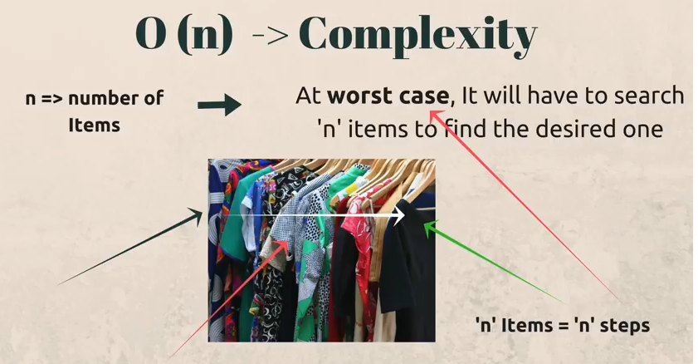

Slide 56
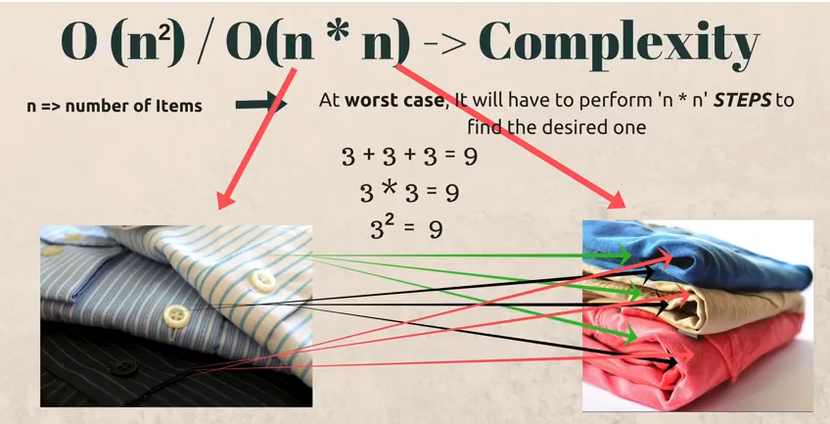

Slide 57
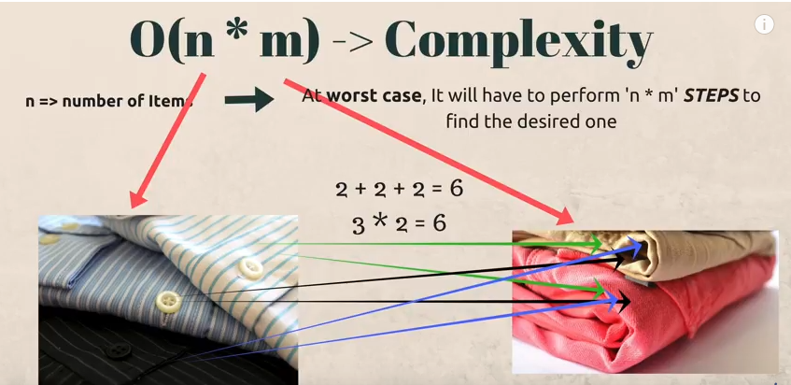

Slide 58
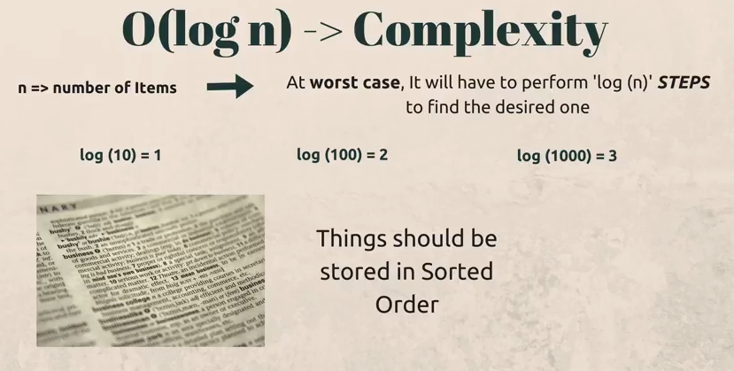
Dictionary

